Slide 1
Online Modeling Training Storyboard
VA Human Factors Services
IDIQ 36C77619D0018 | TO3 36C77619N0147
March 13th 2020

Slide 2
Organization of Storyboard: Course Modules
Short video tutorials w/slide decks include:
Introduction and Foundations of Clinical Workflow Modeling
Notation Styles and Standards
Basic Models in DMN, CMMN, UML
MS Office Buttonology
Visio Buttonology
Eliciting Data for the Creation of Models (Knowledge Elicitation)
Drafting a Model
Validating Your Model
Analyzing Models
Advancing Your Modeling Skills
These tutorials will be stand alone and can be viewed in any order.

Slide 3
Organization of Storyboard: Handouts and Hands-on Activities
Practice Vignettes
Educational Supplements
Basic Models
BPMN Quick Start Guide
BPMN Shapes
CMMN/DMN/UML Overview
Quick Start Guides (areas to be identified)
Tests and Quizzes
Additional Materials: PowerPoint stencil file

Slide 4
Tutorial 1: Introduction and Foundations of Clinical Workflow Modeling

Slide 5
Introduction to all modules in course
This training is adaptive, self-paced, and includes both didactic and hands on tutorials. More specifically this includes:
Short video tutorials
Handouts
Slide decks
Vignettes/examples for practice
Quizzes
Office Hours
This module is didactic with voice-over while reviewing slides. Also includes hands-on activities.

Slide 6
Course Objectives
Learn about Business Process Modeling (BPM) to be able to build, read, and interpret clinical workflow and information flow models.
Obtain background on BPM (This module)
Learn to conduct and document interviews and focus groups to elicit clinical knowledge.
Learn to produce models:
Using tools: MS Office and Visio
Using notations including Business Process Modeling Notation (BPMN), Decision Model and Notation (DMN), Case Management Modeling and Notation (CMMN), and Unified Modeling Language (UML)
Basic and advanced models
Learn to analyze models to determine benefits of procedural and technology changes, and to uncover constraints to system efficiency and work-arounds

Slide 7
Modeling Methodology
Modeling Workflow Use Cases, Scenario and Health Practice Patterns
A Scenario is a detailed outline or synopsis for a specific sequence of events.
A Use Case is composed of multiple scenarios.
1. Knowledge
Elicitation
2. Plan Model
Storyline
3. Develop /
Update Model
4. Assess
Model
5. Lessons Learned

Slide 8
Foundational Modeling Concepts
Traditional Visual Storyboards
Entity Relationship Diagrams (ERDs)
Data Flow Diagrams (DFDs)
State Transition Diagrams (STDs)
Management of Complexity
Component-service Horizontal Decomposition
Lab, Rad, Rx
“Swim Lanes” Stakeholder Perspectives
Hierarchical Decomposition into sub-processes
Encounter (Admissions, Discharge and Transfer)
Reusable EHRM Enterprise Business Model for Sites’ EHRM Transition Plans
Composed of Domain Specific Architecture Use Cases, e.g., Telestroke, Tele-Cardiology
Composed of Health Practice Patterns (HPPs), e.g., Tele-Health
Marriage
Wife
Husband
Send to Printer
Get Data
Print Data
8 hours
Start Work
Finish Work
Option 1 | Task A | Task B
Option 2 | Task M | Task N
Option 3 | Task X | Task Y
Option 1 | Option 2 | Option 3
Task A B C | Task M, N, O | Task X, Y, Z
Sub-Tasks … | Sub-Tasks … | Sub-Tasks …

Slide 9
Foundational Modeling Concepts
Traditional Visual Storyboards
Entity Relationship Diagrams (ERDs)
Data Flow Diagrams (DFDs)
State Transition Diagrams (STDs)
Management of Complexity
Component-service Horizontal Decomposition
Lab, Rad, Rx
“Swim Lanes” Stakeholder Perspectives
Hierarchical Decomposition into sub-processes
Encounter (Admissions, Discharge and Transfer)
Reusable EHRM Enterprise Business Model for Sites’ EHRM Transition Plans
Composed of Domain Specific Architecture Use Cases, e.g., Telestroke, Tele-Cardiology
Composed of Health Practice Patterns (HPPs), e.g., Tele-Health
Flip back and forth between this slide and:
An example of horizontal decomposition/swim lanes
An example of hierarchical decomposition/sub-processes
Marriage
Wife
Husband
Send to Printer
Get Data
Print Data
8 hours
Start Work
Finish Work
Option 1 | Task A | Task B
Option 2 | Task M | Task N
Option 3 | Task X | Task Y
Option 1 | Option 2 | Option 3
Task A B C | Task M, N, O | Task X, Y, Z
Sub-Tasks … | Sub-Tasks … | Sub-Tasks …

Slide 10
Modeling Concepts
Management of Complexity
Component-service Horizontal Decomposition
Lab, Rad, Rx
“Swim Lanes” Stakeholder Perspectives
Hierarchical Decomposition into sub-processes
Encounter (Admissions, Discharge and Transfer)
Reusable EHRM Enterprise Business Model for Sites’ EHRM Transition Plans
Composed of Domain Specific Architecture Use Cases, e.g., Tele-Health
Composed of Health Practice Pattern (HPP) scenarios and models, e.g., Telestroke

Slide 11
Modeling Tools
Modeling notations are used to visually tell a story.
Visual process models: workflows performed by multiple people using technology for information work and/or physical activities.
Select the notation and shapes that works best for you.
You can construct UML, BPMN, CMMN, DMM drawing shapes, using standard Windows or Office
Group constructed shapes and use them as a template
Create a Shape Legend to avoid ambiguity
MS Visio, Sparx EA, IBM RSA, Magic Draw, etc. are other tools you can use.
These are database tools and ensure consistent spelling etc.
VA is considering Trisotech, which is cloud-based

Slide 12
Notation Overview
Modeling Type | When to Use | Scenario
BPMN | Repeatable Processes | Basic Encounter with Triage
CMMN | Ad-Hoc or If/Then Processes | Chronic Care Required (e.g.—Hypertension, Arthritis, Atrial Fibrillation)
Decision Modeling Notation (DMN) | Decision Trees and Truth Tables | Conditions Influence Treatment (e.g.—Age, Weight, Sex, BMI)
UML | Entity Relationship Data and Information Flow | Information flows need to be included
References:
OMG BPMN, CMMN and DMN overview video: https://www.youtube.com/watch?v=N3htv1tjmuc
OMG UML Overview Video: https://www.youtube.com/watch?v=vAHHdnIV8rU
OMG UML for Information Models: https://www.youtube.com/watch?v=HqKZOgvCeUo

Slide 13
Tutorial 2: Notation Styles and Standards

Slide 14
Objective
To understand the various modeling notations including Business Process Modeling Notation (BPMN), Decision Model and Notation (DMN), Case Management Modeling and Notation (CMMN), and Unified Modeling Language (UML)
Learn to differentiate between the various modeling notations, including when and how to use each

Slide 15
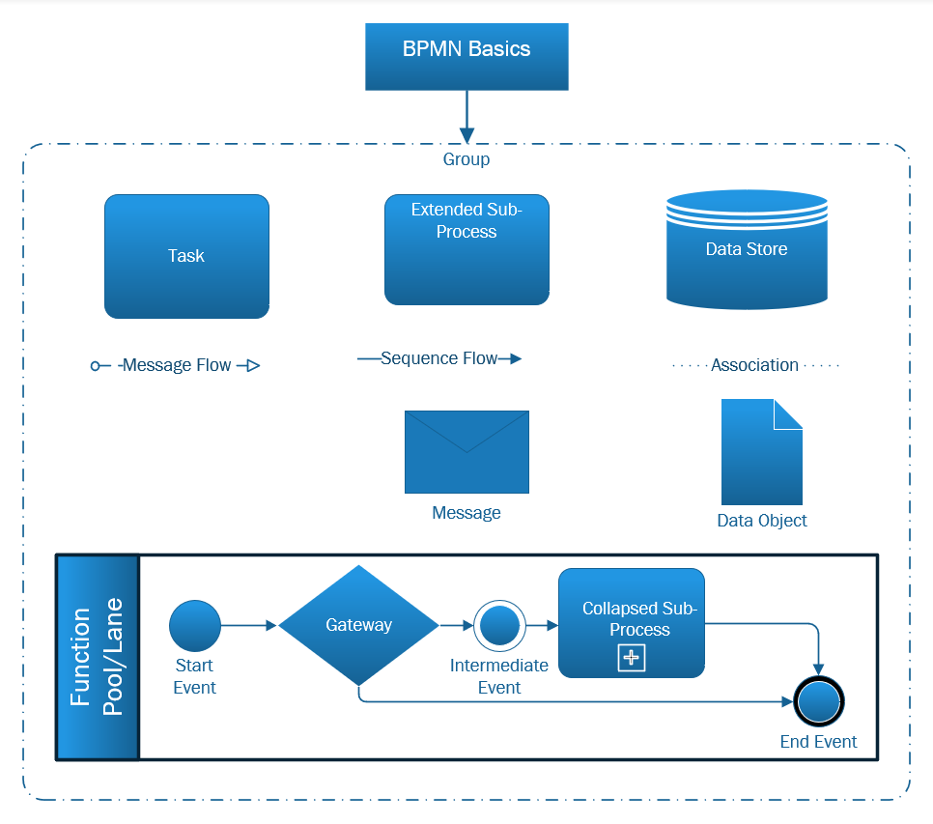
BPMN Basic Notation and Concepts

Slide 16
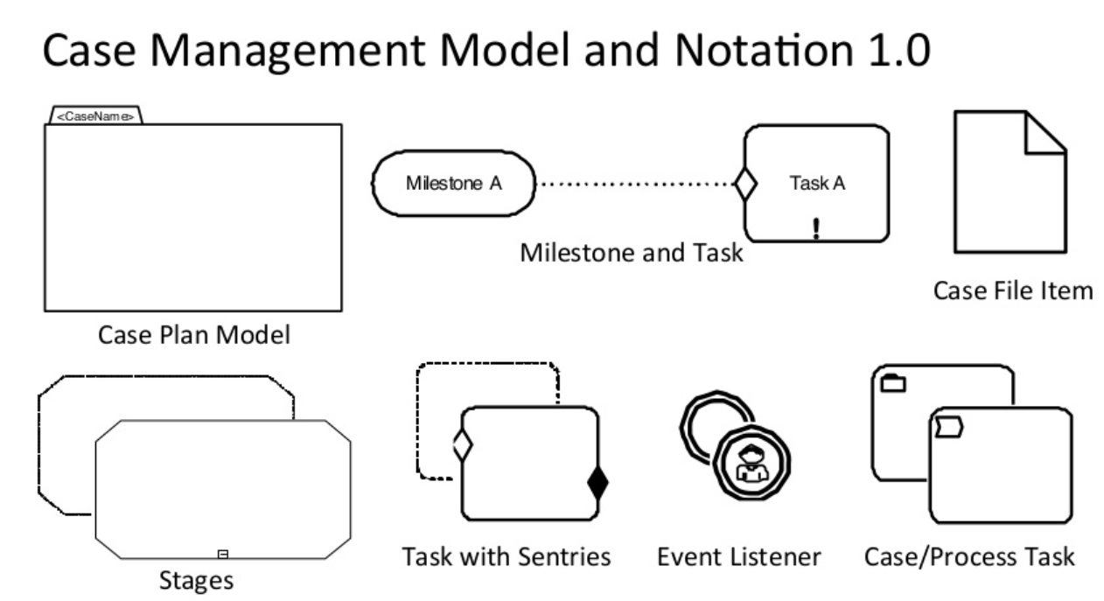
CMMN Basic Notation and Concepts

Slide 17
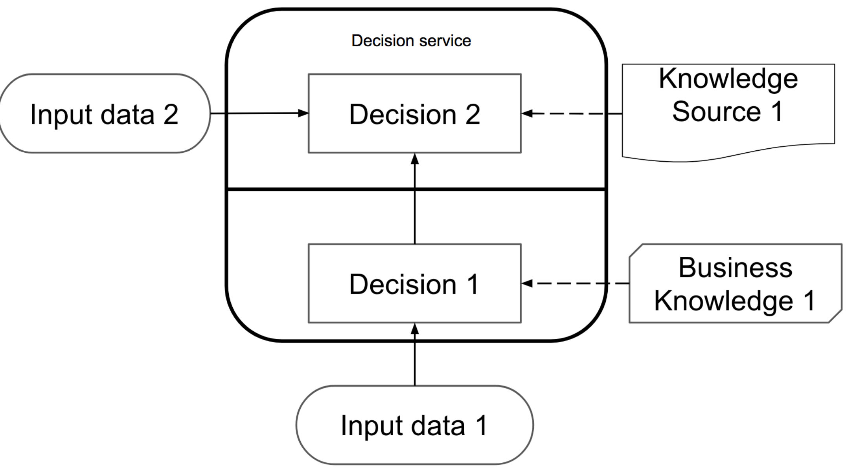
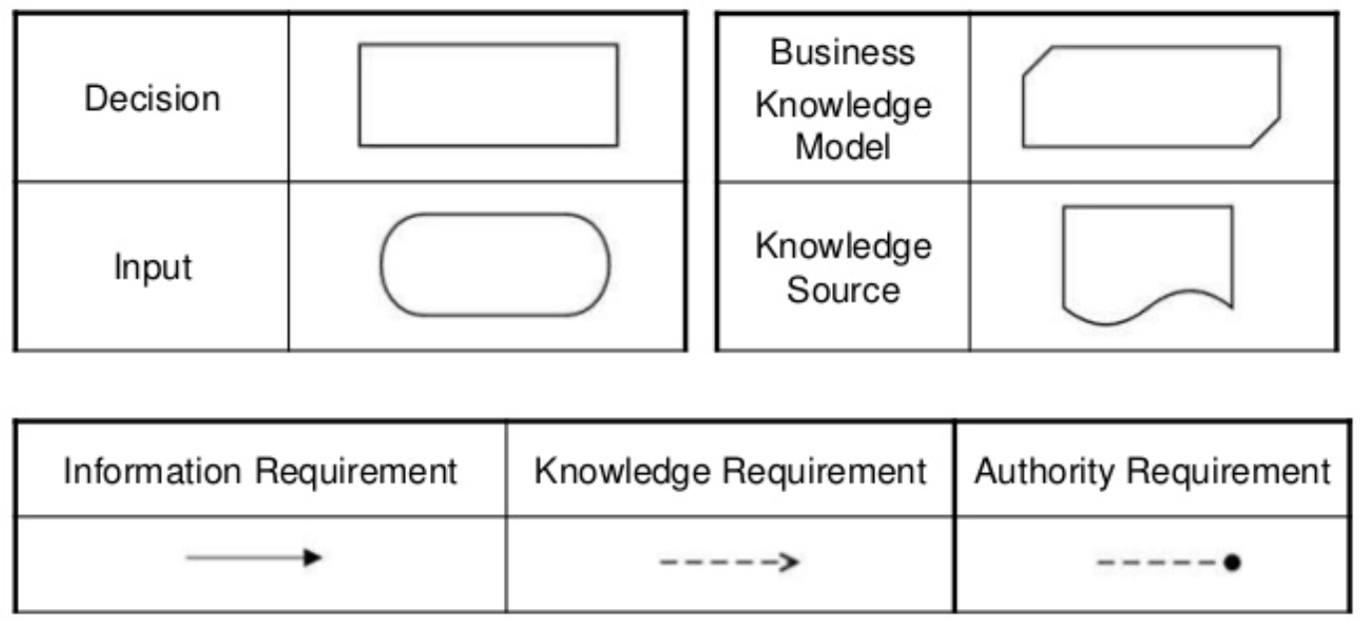
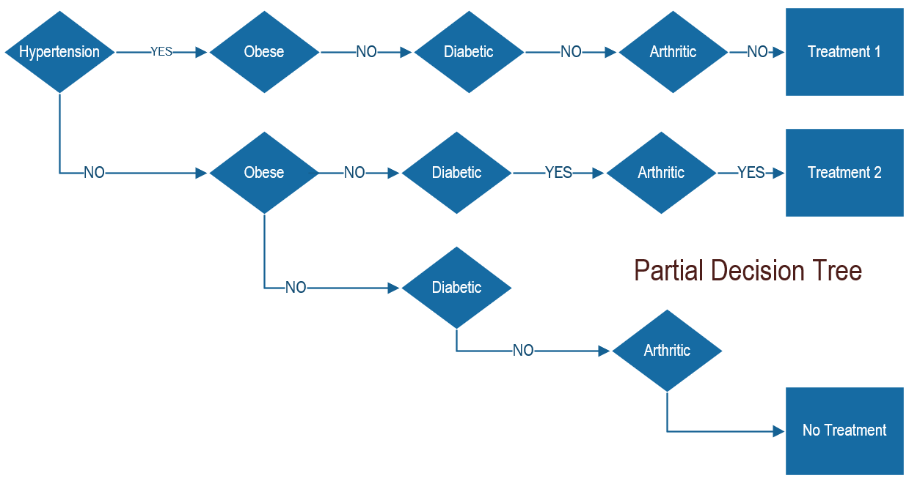
DMN Basic Notation and Concepts
Condition | Partial Decision Table
Hypertension | 0 | 1 | 0 | 0 | 1 | 1 | 1 | 1 | 0
Obese | 0 | 0 | 1 | 0 | 1 | 0 | 0 | 0 | 0
Diabetic | 0 | 0 | 0 | 1 | 0 | 1 | 0 | 0 | 0
Arthritis | 0 | 0 | 0 | 0 | 1 | 0 | 1 | 0 | 0
Action
Treatment 1 | 0 | 1 | 0 | 0 | 0 | 0 | 1 | 0 | 0
Treatment 2 | 0 | 0 | 0 | 0 | 1 | 0 | 1 | 0 | 0

Slide 18
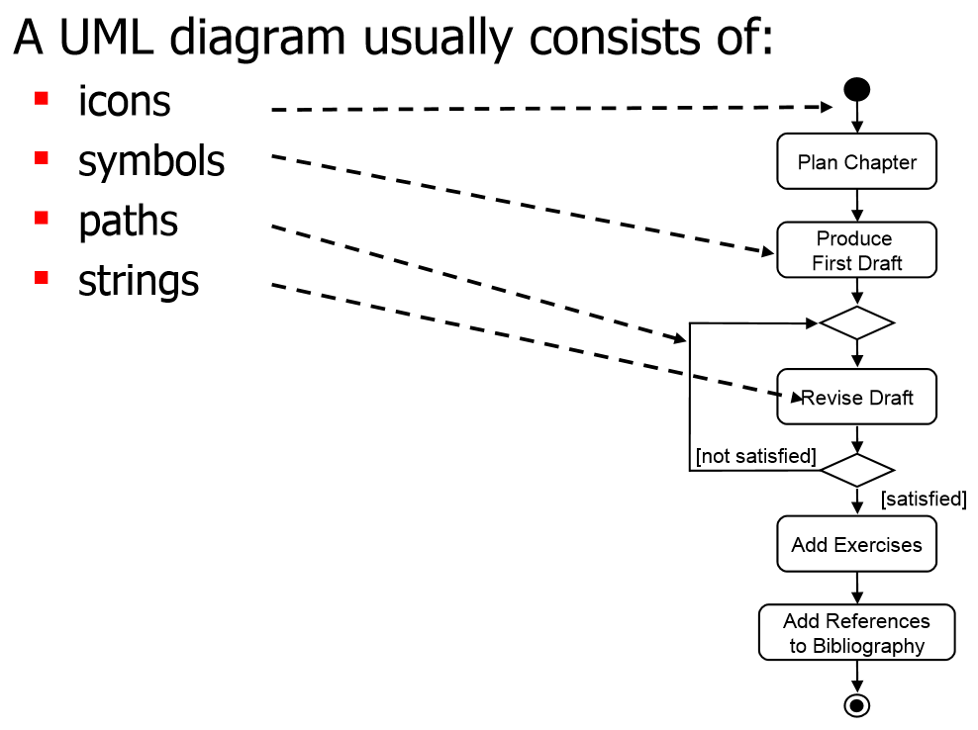
UML Basic Notations and Concepts
Structural UML diagrams
Class diagram
Package diagram
Object diagram
Component diagram
Composite structure diagram
Deployment diagram
Behavioral UML diagrams
Activity diagram
Sequence diagram
Use case diagram
State diagram
Communication diagram
Interaction overview diagram
Timing diagram
Entity A
Relationship
Entity B
Attribute 1
Attribute 2
Attribute 3
…
Attribute 1
Attribute 2
Attribute 3
…
UML Entity Relationship (ER) used to model Information Exchange Requirements (IERs)

Slide 19
Modeling Notation: Compare and Contrast
Modeling Type | When to Use | Scenario
BPMN | Repeatable Processes | Basic Encounter with Triage
CMMN | Ad-Hoc or If/Then Processes | Chronic Care Required (e.g.—Hypertension, Arthritis, Atrial Fibrillation)
Decision Modeling Notation (DMN) | Decision Trees and Truth Tables | Conditions Influence Treatment (e.g.—Age, Weight, Sex, BMI)
UML | Entity Relationship Data and Information Flow | Information flows need to be included
References:
OMG BPMN, CMMN and DMN overview video: https://www.youtube.com/watch?v=N3htv1tjmuc
OMG UML Overview Video: https://www.youtube.com/watch?v=vAHHdnIV8rU
OMG UML for Information Models: https://www.youtube.com/watch?v=HqKZOgvCeUo

Slide 20
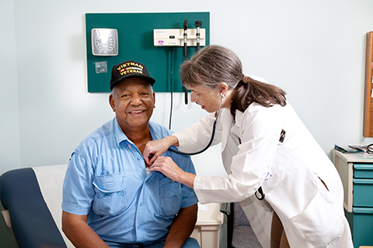
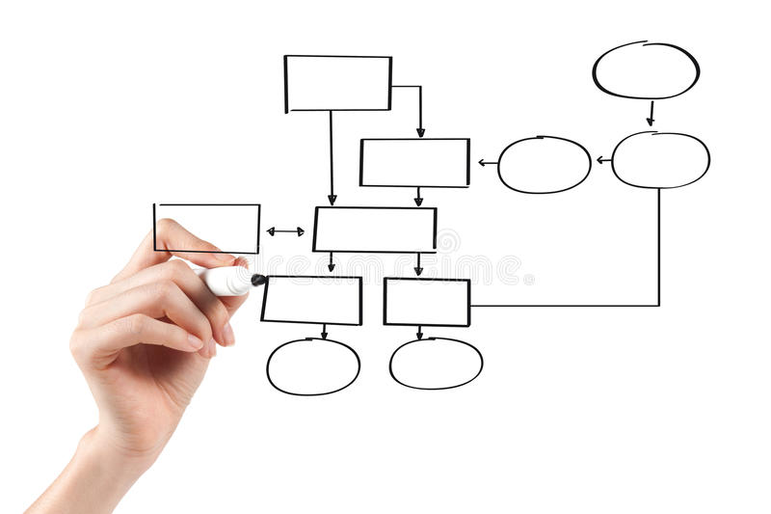
Basic Emergency Encounter: Triage and Immediate Care Required
EXERCISE: Instructor demonstrates, and students duplicate
Determination that emergency requires immediate care
DOA: call coroner.
Life threatening: see clinician immediately.
Otherwise, wait for clinician to become available

Slide 21
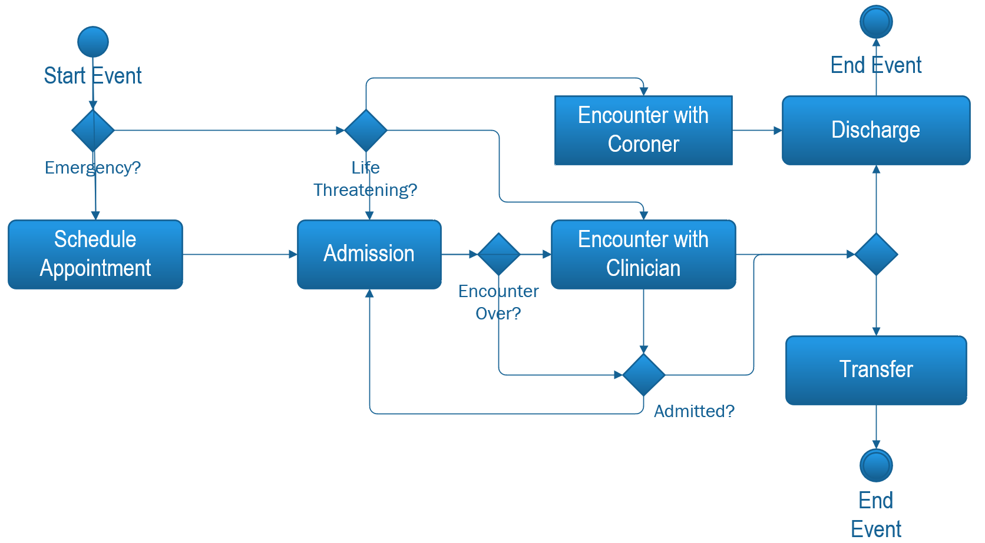
Emergency Encounter: Triage Finished Model

Slide 22
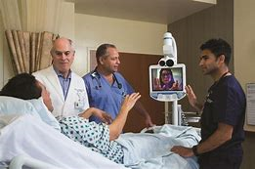
VA National Telestroke Program Video
We will show a portion of this video and provide a link for those wishing to view it in its entirety.
https://players.brightcove.net/2851863979001/default_default/index.html?videoId=6042308325001

Slide 23
Telestroke Model Walk-Through Outline
Identify stroke immediately and transport patient to relevant department for treatment
Recruit as many staff as available for stroke patients
Ensure constant concurrent activity (vitals, documentation, etc.)
Get Telestroke Stand and contact TS Dr with relevant information
Consider Alteplase viability
Transport patient to radiologist for CT & CTA Scan
ED Dr + Nurse conduct neurological exam & NIH Stroke Scale
Calculate Stroke Score
Time Out
Communicate Alteplase risks
Obtain patient consent
Calculate Alteplase dosage + confirm
Administer Alteplase

Slide 24
Emergency Encounter with Telehealth Consult
Include a workflow model in BPMN based on a simplified version of the Telestroke video/consult

Slide 25
Other Notations
We will cover, in depth, some of the symbols from the other notation standards that are not in the BPMN symbol set, and present one model built in one of the other standards.

Slide 26
Tutorial 3: Basic models in CMMN, DMN, UML

Slide 27
Objective
Learn the CMMN, DMN, and UML notation standards and better understand their application.
Voice-over will reiterate the different standards provided in the notation module, then compare and contrast between them, etc.

Slide 28
Modeling Notation: Compare and Contrast
Modeling Type | When to Use | Scenario
BPMN | Repeatable Processes | Basic Encounter with Triage
CMMN | Ad-Hoc or If/Then Processes | Chronic Care Required (e.g.—Hypertension, Arthritis, Atrial Fibrillation)
Decision Modeling Notation (DMN) | Decision Trees and Truth Tables | Conditions Influence Treatment (e.g.—Age, Weight, Sex, BMI)
UML | Entity Relationship Data and Information Flow | Information flows need to be included
References:
OMG BPMN, CMMN and DMN overview video: https://www.youtube.com/watch?v=N3htv1tjmuc
OMG UML Overview Video: https://www.youtube.com/watch?v=vAHHdnIV8rU
OMG UML for Information Models: https://www.youtube.com/watch?v=HqKZOgvCeUo

Slide 29
Basic Models
We will add one simple model for each of the three standards being covered in the training.
[Placeholder – models not constructed yet; they will be similar in complexity to the BPMN example in the Intro module, and the format of the instruction will be the same, i.e., didactic.

Slide 30
Tutorial 4: MS Office “Buttonology”

Slide 31
Objective
Learn to produce simple models in Microsoft PowerPoint
Voice-over will explain that there are specialized tools that help users create workflow models, (i.e. Visio), which allow models to be built and worked with more efficiently, but this module is for those who don’t have easy access to Visio or other specialized tools or do not have the time to learn them.
Note:
-We will let the audience know that these tools are readily accessible on the VA network
-If you will be performing modeling more often/extensively, we recommend that you get familiar with MS Visio and take the Visio Buttonology module

Slide 32
Basic Emergency Encounter: Triage and Immediate Care Required
EXERCISE: Instructor demonstrates, and students duplicate
Determination that emergency requires immediate care
DOA: call coroner.
Life threatening: see clinician immediately.
Otherwise, wait for clinician to become available

Slide 33
Basic Emergency Encounter: Triage and Immediate Care Required
EXERCISE: Instructor demonstrates, and students duplicate
Determination that emergency requires immediate care
DOA: call coroner.
Life threatening: see clinician immediately.
Otherwise, wait for clinician to become available
Voice-over: “You may recognize this encounter from one of our other modules. If not, that’s ok. We’re going to show you how to use Microsoft PowerPoint to build workflow models for simple clinical encounters.”

Slide 34
Emergency Encounter: Triage Finished Model
Voice-over: “This is what the finished model will look like.”

Slide 35
BPMN Basic Notation and Concepts
First a review of the basic notation standards in BPMN.
This portion is essentially the same as in the Notation module.
“We’ll touch on other notation standards, like DMN, CMMN, and UML, briefly. You can learn more about them in the Notation module”.

Slide 36
BPMN Basic Notation and Concepts

Slide 37
PowerPoint Hands-On
Instructions for the course will have students open PowerPoint on their machine before beginning. At this point the training will have a screencast of the triage model shown earlier being built in PowerPoint, with voice-over.

Slide 38
VA National Telestroke Program Video
We will show a portion of this video and provide a link for those wishing to view it in its entirety.
https://players.brightcove.net/2851863979001/default_default/index.html?videoId=6042308325001

Slide 39
PPT Hands-On Activity
At this point the training will have a screencast of the simplified Telestroke model shown earlier being built in PPT, with voice-over.

Slide 40
PowerPoint Hands-On: Other notations
We will cover some of the symbols from the other notation standards that are not in BPMN and how to generate them in PPT. Add one full (fairly basic) model built in one of the other standards, and touch on the others.

Slide 41
Tutorial 5: MS Visio “Buttonology”

Slide 42
Note – this is very similar to the slides for Office/PPT buttons. Many of the slides are duplicates or nearly so.

Slide 43
Objective
Learn to produce simple models in Microsoft Visio
Voice-over will explain that MS Visio is highly accessible on the VA network (and accessible/affordable to the general public as part of some versions of Office.) For anyone only requiring read access to models built in Visio, its diagrams can be pdf’d or can be opened in web browsers. Visio’s features make it easier than standard Office tools to build and edit workflow models (it also supports several other types of diagrams.)
If you don’t expect to be doing a lot of modeling but want to be able to occasionally build a very simple model, consider taking the Office “buttonology” model.
Tell them what to expect in the training – hands on exercises etc. – “open Visio now, if you don’t already have it open. This module and this course will not make you a Visio power user but will provide proficiency at using it to construct WFM’s in BPMN and other notations.”

Slide 44
Basic Emergency Encounter: Triage and Immediate Care Required
EXERCISE: Instructor demonstrates, and students duplicate
Determination that emergency requires immediate care
DOA: call coroner.
Life threatening: see clinician immediately.
Otherwise, wait for clinician to become available

Slide 45
Basic Emergency Encounter: Triage and Immediate Care Required
EXERCISE: Instructor demonstrates, and students duplicate
Determination that emergency requires immediate care
DOA: call coroner.
Life threatening: see clinician immediately.
Otherwise, wait for clinician to become available
Voice-over: “You may recognize this encounter from one of the other modules in this course. If not, that’s ok. We’re going to show you how to use Microsoft Visio to build workflow models for simple clinical encounters.”

Slide 46
Emergency Encounter: Triage Finished Model
Voice-over: This is what the finished model will look like.

Slide 47
BPMN Basic Notation and Concepts
First a review of the basic notation standards in BPMN.
This portion is essentially the same as in the Notation module.
Voice over: We’ll touch on other notation standards, like DMN, CMMN, and UML, briefly. You can learn more about them in the Notation module.
Notes:
Change intro module to notation module (twice)

Slide 48
BPMN Basic Notation and Concepts

Slide 49
Visio Hands-On
Instructions for the course will have students open Visio on their machine before beginning. At this point the training will have a screencast of the triage model shown earlier being built in Visio, with voice-over.

Slide 50
VA National Telestroke Program Video
We will show a portion of this video and provide a link for those wishing to view it in its entirety.
https://players.brightcove.net/2851863979001/default_default/index.html?videoId=6042308325001

Slide 51
Telestroke Model Walk-Through Outline
Identify stroke immediately and transport patient to relevant department for treatment
Recruit as many staff as available for stroke patients
Ensure constant concurrent activity (vitals, documentation, etc.)
Get Telestroke Stand and contact TS Dr with relevant information
Consider Alteplase viability
Transport patient to radiologist for CT & CTA Scan
ED Dr + Nurse conduct neurological exam & NIH Stroke Scale
Calculate Stroke Score
Time Out
Communicate Alteplase risks
Obtain patient consent
Calculate Alteplase dosage + confirm
Administer Alteplase

Slide 52
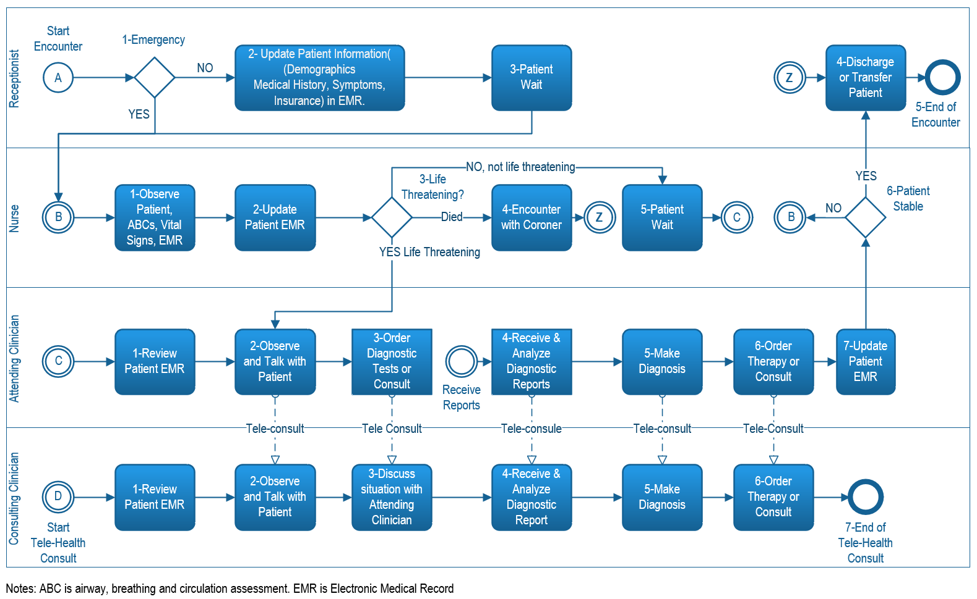
Emergency Encounter with Telehealth Consult
Replace with a simplified version of one of the real TS models
Voice-over: This is what the finished model will look like.

Slide 53
Visio Hands-On
At this point the training will have a screencast of the simplified Telestroke model shown earlier being built in Visio, with voice-over.

Slide 54
Visio Hands-On: Other notations
We will cover some of the symbols from the other notation standards that are not in BPMN and how to generate them in Visio.
Add one full (fairly basic) model built in one of the other standards, and touch on the others.

Slide 55
Tutorial 6: Eliciting Data for the Creation of Workflow Models

Slide 56
Objective
Learn the definitions and foundational concepts of methods for eliciting knowledge on clinical workflows, such as observations*, interviews, focus groups*, walkthroughs/tabletops, and simulations
Guidelines for selecting methodologies
Best practices for each
Using collected data to draft initial model
* Key techniques for VHA clinical workflow modeling.

Slide 57
What is Knowledge Elicitation
Provide a functional definition with high level examples

Slide 58
Purpose of Knowledge Elicitation
Understand the roles, activities and interactions in a clinical workflow
Systematically collect information in a form that can be used to build a model

Slide 59
Overview of Knowledge Elicitation Methods
Vary in complexity
Model construction (from “scratch”) vs. model validation
Many workflow modeling efforts contain both
Elicit→Build→Validate
There is overlap between the techniques, e.g., between interviews and focus groups, both of which entail discussions outside of a (real or simulated) work environment; and between walkthroughs and simulations, which are areas on a continuum of complexity rather than distinct methods.

Slide 60
Observations
What are they
The modeler observes the workflow in a live setting
One form of observation is a Gemba walk
…
Graphic here
Best Practices
Template/form for data collection
Capture variability: multiple events/care teams/facilities
Immediate (initial) validation: ask a cognizant person how typical was the event(s) you observed

Slide 61
Interviews
What they are
The modeler/facilitator interviews clinicians regarding the workflow
One-on-one or with multiple interviewers
…
Graphic here
Best Practices
Go in with a basic description of the process
Capture variability: multiple events/care teams/facilities
Output can be general notes or a textual narrative

Slide 62
Focus Groups
What they are
One or more modelers/facilitators discuss the workflow with a group of clinicians
Somewhat of a continuum with interviews; focus groups can -- and sometimes should -- have the flavor of a “group interview” – e.g. ask the same question 1-1 of each participant.
Graphic here
Best Practices
Go in with a basic description of the process
Get basic questions answered with interviews or preliminary e-mail discussion with participants
Outputs can include textual narrative, rough flow drawings, whiteboards/stickies

Slide 63
(Cognitive) Walkthroughs
What they are
Shares characteristics with a focus group, but is driven by one or more scenarios
The modelers/facilitators step the participants through the scenario (or each scenario) and systematically capture what they would be doing and thinking
…
Graphic here
Best Practices
Often the method of choice for a process that does not exist yet, but can also be used, e.g., for less-common but critical scenarios in current practice
Input is a narrative, represented in text or (usually better) slide deck with graphics/mockups/videos)

Slide 64
Tabletop Exercises
What they are
A more interactive form of cognitive walkthrough, where participants make decisions that affect the next step in the scenario
Begin with structure but can go in unplanned directions (which is often when the best data are gathered)
Graphic here
Best Practices
Flexibility required, including facilitators and participants working together to explore what would happen when scenario goes in a direction not anticipated by the prepared materials

Slide 65
Simulation
What it is
Scenario-based evaluation assisted by technology that emulates aspects of the working environment
Can be experimental, with controlled scripted scenarios, or free-running (incorporating some features of the observation technique) – or a combination/middle ground
…
Graphic here
Best Practices
Collaboration of clinicians and simulation experts is essential to design and validate useful scenarios and scripts.
…

Slide 66
Compare and Contrast
 | Level of Effort | Types of Data | Example Applications/Indications
Observation
Interviews
Focus Groups
Cognitive Walkthroughs
Tabletops
Simulation

Slide 67
Considerations for Selecting Methods
Complexity of the workflow/practice
Complexity/level of effort of methods
Resources (modelers, participants, facilities, calendar time i.e. deadlines)

Slide 68
Tutorial 7: Drafting a Model

Slide 69
Objective
Learn how to use information obtained during knowledge elicitation or from other sources to create initial models

Slide 70
Text narrative
From notes
As-is and to-be
Represent differences using track changes
Pain points
Exceptions/special cases

Slide 71
Flow diagrams
Select a notation standard(s)
Sketch high-level model
Stickies/Post-its
(Often done in the focus groups themselves)
Tasks
Data
Swim lanes
Decision points/branches
Where appropriate, draft model directly in Visio or PowerPoint
Flip to slide(s) from other module(s) showing the different notations/standards and refer them to other modules to learn the details.
Perform sketching to determine complexity of model, whether multiple models are needed or just a hierarchy, possibly to select which tool to use.
Graphics to be added.
Discuss how to decide when to start building a model in your app, including assessing the maturity of your sketch.

Slide 72
Tutorial 8: Validating a Model

Slide 73
Objective
Understand the importance of validating your model
Learn the methods used for validating models based on resources available

Slide 74
Validation (1 of 2)
Typically done in focus group
Preparation:
Identify needed roles
Confirm format of validation session; e.g., may want or need individual interviews depending on staff availability and other factors
Identify specific clarification questions
Presentation:
Present model(s): encourage them to keep an eye out for pain points and “likes”
Discourage interruptions (helps to provide pen and paper to note inaccuracies and pains/likes)
“Go with the culture” of the group

Slide 75
Validation (2 of 2)
Critical incident technique:
Tease it out further with best-case and worst-case real-world examples
Note: can give great data but can be time-consuming
Discussion:
Anything missing?
Can any steps in the flow be combined or eliminated?
Explicitly ask about pains and likes – general
Explicitly ask what can be time-consuming, and what can cause errors – word questions carefully so as not to make it about blame.

Slide 76
Tutorial 9: Analyzing Models

Slide 77
Objective
Learn to read and interpret workflow models to:
Understand the workflow of a process you participate in or manage
Identify areas for improvement in current practice
Assess benefits of proposed or pending technology or procedural changes

Slide 78
Show Telestroke models with pharmacist at bedside and in pharmacy as an example of two different versions that can be compared. These will be shown and referred to throughout the module.
Voice-over: we will use one or both models to illustrate the different kinds of objective/subjective, and quantitative/qualitative data that you can extract from completed and validated workflow models.

Slide 79
Timing
Absolute timing
Relative to other events

Slide 80
Errors
Actual or “actual”
As seen in observations or walkthroughs/simulations
Potential
Explicitly mentioned in interviews and focus groups, might be represented as decision points in model

Slide 81
Resource usage
Examine swim lanes and interactions to determine redundant or missing resources (human, tools, or data)

Slide 82
Tutorial 10: Advancing Your Modeling Skills

Slide 83
Objective
Starting with one or more text narrative(s) of clinical vignette(s), build one or more workflow models from scratch.

Slide 84
Include a short version/refresher of basic model building, followed by a short version/refresher of the “initial model drafting” portion of the “Eliciting Data/Knowledge Elicitation” module, referring students to that module if they need it.
Step through an example (e.g., Telestroke) showing how we went from the video to a model, and note that you could have done the same thing by doing observation if (as is usually the case) someone hasn’t made a video about it.

Slide 85
Now, refer to your handout and select one (or more) of the vignettes to model.

Slide 86
Handouts: Vignettes

Slide 87
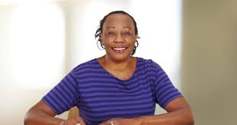
Encounter Vignette: Persistent Cough
Janet is 54 years old and has arrived at the primary care clinic complaining of a persistent cough that has lasted more than 3 months. Janet is a lifelong smoker and has a history of asthma, although she has not experienced asthma symptoms since childhood. Upon arrival Janet checks in at the front desk and proceeds to the waiting room. When called, she is met by the medical assistant who obtains her weight, vitals, medical history, and symptomology which are entered into the electronic medical record (EMR) before the doctor is called in.
Upon entering the exam room, the primary care provider (PCP) reviews the chart, noting Janet’s asthma and smoking history. The PCP performs a physical exam and notes the audible wheeze upon chest auscultation. COPD is suspected based on Janet’s age, smoking/medical history, and symptoms. The doctor recommends that a pulmonary function test be performed to differentiate between COPD or other lung conditions. The doctor refers Janet to a pulmonologist who can administer spirometry testing.
Janet makes an appointment with a Pulmonologist in the same clinic and returns the following week.

Slide 88
Encounter Vignette: Persistent Cough (cont.)
At the Pulmonologist appointment, Janet is first met by a respiratory therapist (RT) who accesses Janet’s record and notes her medical history and symptoms. The RT also obtains Janet’s weight, height, age, which is needed to calibrate the spirometer. The RT confirms this information with Janet before starting the first of two spirometry tests. The first test reveals a Forced Expiratory Ratio (FER) of 0.4. In order to rule out a reversible airway condition such as asthma, the RT administers a bronchodilator (quick reliever) inhaler before administering the second spirometry test. A reading of <0.7 after a bronchodilator is administered would indicate COPD or obstructive lung disease. Janet’s 2nd PFT is administered and reveals a FER of 0.4 indicating that her lung function remained diminished and had not reversed, indicating a diagnosis of COPD. These readings and Janet’s diagnosis are entered into the EMR by the RT.
After spirometry testing, the Pulmonologist enters the exam room. He reviews the PFT results and explains the results to Janet. He offers options and recommendations for COPD treatment as well as patient education. He offers Janet a referral to the clinic’s smoking cessation program which Janet accepts. A tobacco counselor from the program enters the exam room and offers Janet options to help her quit smoking. Janet enrolls in tobacco group counseling with the counselor. At the end of the clinical encounter, the Pulmonologist writes three prescriptions, two for COPD and one smoking cessation aid. Janet is told to return for a follow up appointment with the Pulmonologist in 6 weeks. She must also return for weekly tobacco group counseling sessions.

Slide 89
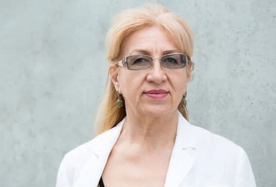
Encounter Vignette: Diabetes
Beverly is a 60 year old Veteran who was previously diagnosed with diabetes by her Primary care Provider (PCP). During her last appointment, the PCP referred Beverly to a local Endocrinologist. Beverly attends her first Endocrinology appointment with her adult daughter. She is given intake forms to complete however due to her growing vision problems, her daughter must complete the forms for her mother. She is called by the intake nurse who takes Beverly and her daughter to an exam room. While in the room with Beverly, the nurse enters Beverly’s weight, blood pressure, and medical history into the electronic record. Beverly explains that she has “felt lightheaded for the fast few days”, and has also been experiencing extreme fatigue. The nurse notes that Beverly’s Hemoglobin A1c (HbA1c) was last checked 4 months ago.
The Endocrinologist enters the encounter and reviews the patient chart. She notes that Beverly’s HbA1c has been elevated for the last year. It is a standard in the Endocrinology practice to perform new labs on all new patients. An order is placed for a fasted HbA1c and blood glucose panel however Beverly must return on a different day since she had eaten earlier in the day. The Endocrinologist performs the physical exam and notes physical signs of dehydration. The Endocrinologist adds potassium and sodium blood tests to Beverly’s lab order to confirm dehydration. She does not adjust Beverly’s medications until an updated A1c test is performed. The clinical encounter ends with Beverly being discharged by the intake nurse. She is given instructions for treating dehydration at home and is told to return the next day for labs.

Slide 90
Encounter Vignette: Diabetes (cont.)
Beverly and her daughter return for labs the following day. Beverly checks in at the front desk and waits to be called for lab work. The Phlebotomist calls Beverly to the lab for the blood draw. After the draw, Beverly is told to return to the waiting room to await results and consultation with the Endocrinologist. The Phlebotomist sends Beverly’s blood samples to the on-site lab for processing. The Laboratory Technologist processes the samples and records the results in medical record.
The Endocrinologist reviews Beverly’s results in the electronic medical record. Beverly’s results indicate severely high blood glucose levels and an HbA1c of 8.4 (Normal A1c is 5.7 or below). Results indicate that her diabetes is not well controlled which may be the cause of her worsening symptoms. The Endocrinologist is now concerned that Beverly may be at risk for a diabetic ketoacidosis. Beverly’s sodium and potassium levels also indicate that she is experiencing severe dehydration. The Endocrinologist believes that Beverly should be admitted to the hospital.
Beverly is admitted to the hospital for treatment. The Endocrinologist has ordered intravenous (IV) medications to treat dehydration. Insulin is also ordered to return Beverly’s high blood glucose levels to “stable”. After being roomed, Beverly is seen by the on-call nurse, who starts treatment. Beverly’s Endocrinologist is also on-call, and is able to oversee her in-hospital treatment and monitor her condition. Beverly receives treatment for two days until her blood glucose levels have stabilized. Beverly’s blood glucose and electrolyte levels are continuously monitored during the hospitalization. After two days, Beverly’s levels improved and the Endocrinologist orders her discharge

Slide 91

Encounter Vignette: Severe Headache
Michael, 35 years old, arrives at the Emergency Room complaining of severe headaches. He arrives to the intake desk with his 8-year-old daughter, April. He reported that after he picked April up from school, he developed a minor headache that worsened into a throbbing pain on the left side of his head combined with vomiting and distorted vision. In triage, Michael reports a history of migraines, anxiety, and PTSD after his service in the Marines. (He was discharged after sustaining a head injury.) He experiences a migraine about every two months and takes OTC analgesics whenever he gets them. When asked why he came to the ER, he stated that this headache felt like the “worst ever” and he did not feel safe to drive home. His vitals are taken, and he is sent to the waiting area with his daughter until the doctor becomes available.

Slide 92
Encounter Vignette: Severe Headache (cont.)
While waiting for the provider, Michael’s condition worsens. He complains to the Medical Support Assistant (MSA) about the wait and others being seen before him. The MSA assures him that he will be seen in a timely manner. As he walks back to his seat, he loses his balance and falls to the floor. He begins to convulse and appears to have a seizure. MSA gets the triage nurse and ER provider; seizure protocol begins. The MSA moves the furniture for Michael’s safety, the provider turns him on his side, the nurse guides April to a consultation room away from the event and returns to assist the team.
Once he has stabilized, he is roomed and examined by the provider. Michael states that he has no history of epilepsy. A CT scan is ordered, and Michael is transferred to Radiology Department.
The scans reveal that Michael has suffered a "Thunderclap Headache" a symptom of a subarachnoid hemorrhage (bleeding in the brain) caused by a ruptured aneurysm. He is admitted in intensive care while waiting for emergency surgery.

Slide 93
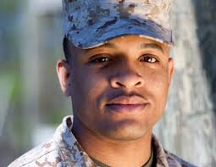
Encounter Vignette: Back Pain
Jacob is a 27-year-old Air Force Veteran. He makes an appointment for his yearly physical with his regular PCP. As he is brought to the exam room, the nurse notices Jacob has a limp and is struggling to sit down comfortably. Although his vitals are normal, the nurse notes a 30-pound weight gain since his last physical. He states that he threw his back out playing basketball with his nephews a few months ago and hasn’t been physically active since his injury. The PCP performs a physical exam and notices Jacob’s shoulders shunted to the left and his spine slanted in the same direction. Jacob also complains of a “stabbing pain” in the center of his back that radiates down the back of his right leg stopping at his ankle. After positive signs on neurodynamic and neurologic examinations (straight leg raising test, reflexes), the PCP orders CT and MRI scans, prescribes 500 mgs of Naproxen, and tells Jacob to schedule a follow up in two weeks. Jacob proceeds to the check out and makes his appointment accordingly. The receptionist gives him a slip to take to the Radiology Department which is in the same complex.

Slide 94
Encounter Vignette: Back Pain (cont.)
After stopping at the information desk to get directions, Jacob arrives in Radiology, hands his paperwork to the intake personnel, and meets the technician who takes his scans. Jacob is instructed that he will see the results during his follow up with his PCP.
The radiologist reads Jacob’s scans and sends the results to his PCP. At the scheduled follow up the provider confirms that Jacob has L5S1 protrusion with right S1 nerve root compression (lumbar herniated disc with associated radiculopathy). Jacob states that he is reluctant to have surgery and asks his provider for other alternatives. The PCP continues him on the same anti-inflammatory medication and orders physical therapy two times per week for 1 month. A follow up is scheduled next month at the registration desk.

Slide 95
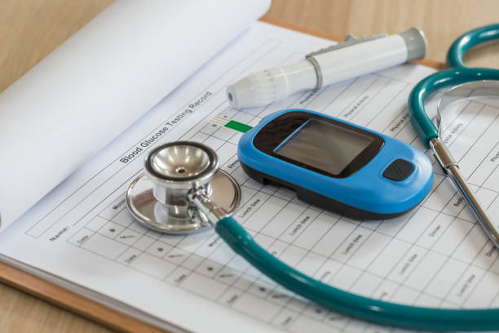
Encounter Vignette: Diabetes #2
This vignette centers on a new patient visit by an individual seeking diabetes care. The patient presents with an extensive medical and social history. Obtaining history elements is necessary to reveal the coinciding depression and multiple social issues the patient was experiencing. The patient’s emotional state is harried and agitated yet in a depressive mood. Specific details surrounding the patient's recorded blood glucose levels, such as values and times measured, are necessary in tailoring clinical management. Moreover, accurately conveying the patient counseling conducted during the encounter is also important, such that future healthcare providers can ensure the patient remains compliant with medical recommendations.

Slide 96
Possible vignettes to add
HR functions: leave, hiring, QA
Suicide prevention
Changing providers
*Transitioning into or out of mental health or between specialties*
Scheduling/fitting in walk-ins/open access*
Intakes
We will develop 1-2 new vignettes. The starred/underlined ones might be the most promising with “Open Access” being mentioned multiple times in the focus groups. The “transitioning” vignette offers several advantages: (1) tie-in with Psych Tools; (2) mentioned multiple times in focus groups; (3) could be good example for decision-tree modeling/DMN.

Slide 97
Handouts: Educational supplements

Slide 98
Handouts to Supplement Tutorials
Basic Models
BPMN Quick Start Guide
BPMN Shapes
CMMN/DMN/UML Overview
Quick Start Guides (areas to be identified)

Slide 99
Tests/Quizzes (pre, post)

Slide 100
Content of tests TBD pending finalization of content

Slide 101
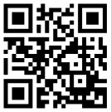
Corporate Headquarters
4031 University Dr., Suite 100
Mason Enterprise Center – Fairfax Fairfax, VA- 22030-3409
(703) 766-4675 Office
(703) 934-2028 Fax
Louisiana Office 201 Saint Charles Ave., Suite 2500
Capital One Building
New Orleans, LA 70170
(504) 754-6839 Office
(703) 934-2028 Fax

